Slide 1
Introduction to Python
…mainly for MATLAB Users

Slide 2
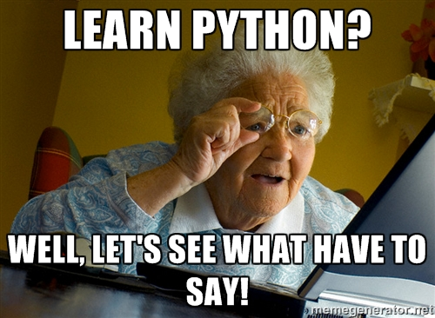
Presentation not intended to teach Python programming language.

Slide 3

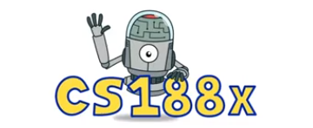
How did I get started?
2012 - Artificial Intelligence Course at UC Berkeley,
Matlab license expensive for hobby projects (>1000EUR),
Data science projects I wanted to experience with:
Machine Learning
Deep Learning
Web apps, interactive, scientific plots
SDR, Gnuradio
Etc.

Slide 4
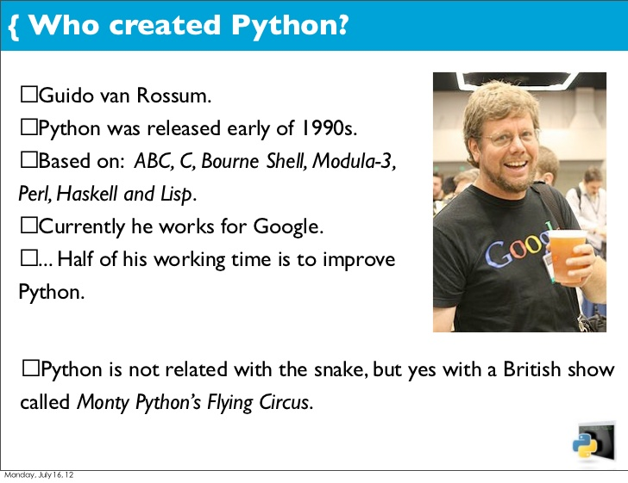
What it is?
Open source, general-purpose language,
Object Oriented, Procedural, Functional,
Interpreted language (…although standalone executable can be compiled)
Dynamical typing
Excellent interactive environment

Slide 5
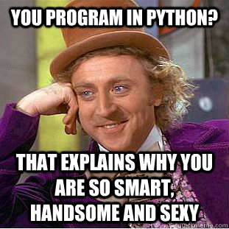
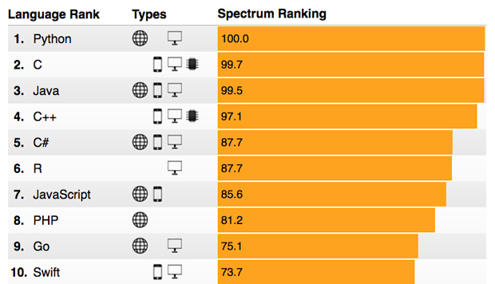
The 2017 Top Programming Languages
https://spectrum.ieee.org/computing/software/the-2017-top-programming-languages

Slide 6
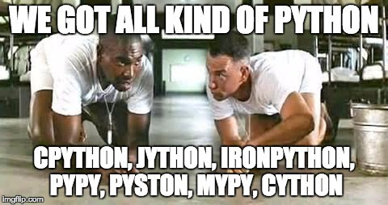
Distributions
Two major versions at the moment:
Python 2.7.x
Python 3.x
http://www.python.org
You probably want 3.x if you are starting from scratch
Multiple scientific bundle
Enthought Canopy
WinPython
Python(x,y)¶
Continuum Analytics Anaconda

Slide 7
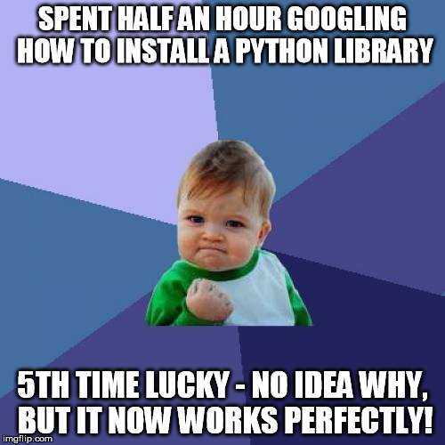
Installation
Python comes pre-installed with Mac OS X and Linux.
Windows binaries from http://python.org/
Anaconda for Scientific work https://www.anaconda.com/download/#windows
Portable Python also available

Slide 8
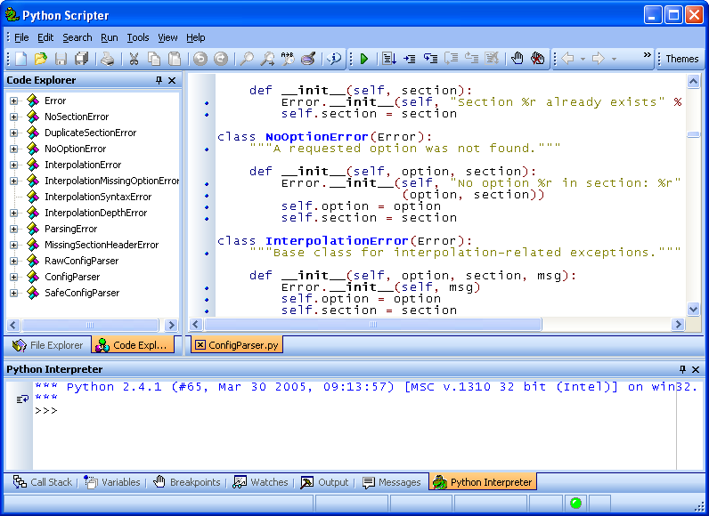
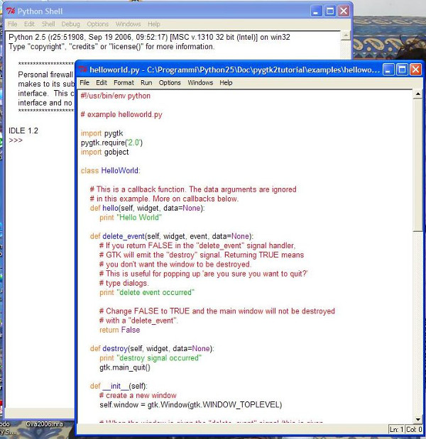

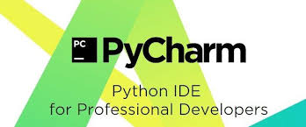
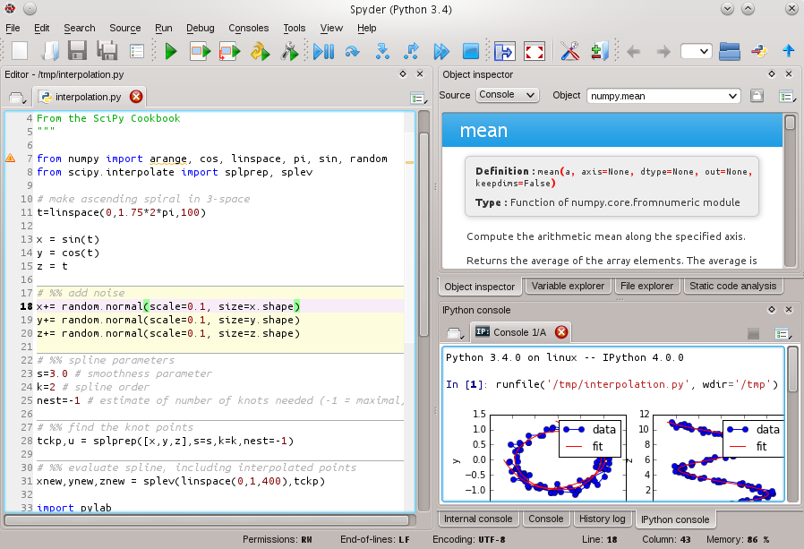
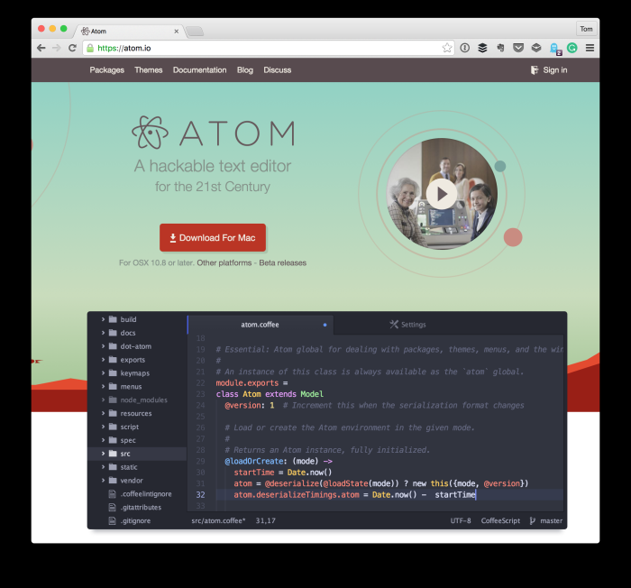
IDE
Python IDE – IDLE
PyScripter (Portable python)
Spyder (Anaconda) – Matlab like experience
Jupyter
PyDev (Eclipse plugin)
PyCharm (JetBrains – IntelliJ IDEA)
Atom (…cool kids)
Visual Studio
Notepad++
….

Slide 9
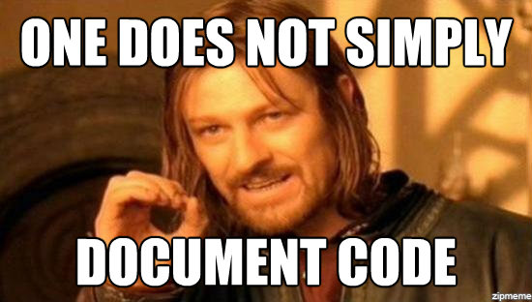
Documentation
Online documentation available at: https://docs.python.org/3/,
IDE help links to online documentation,
Local files – pdf, html, etc.,
IDE code completion,
Many Matlab-Python cheat sheets

Slide 10
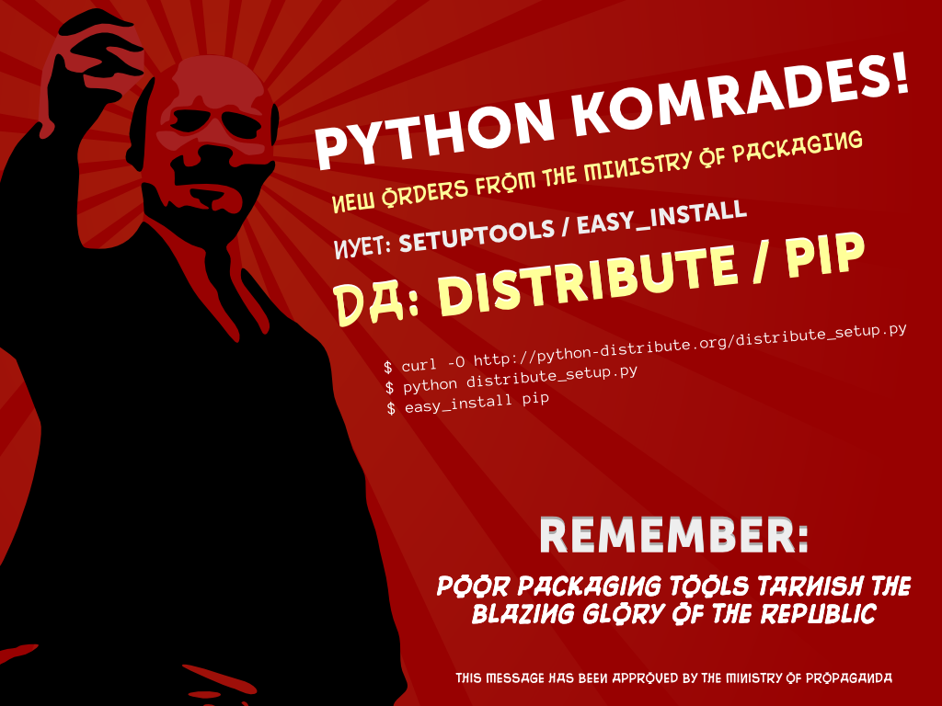
Packages
“The Python Package Index is a repository of software for the Python programming language. There are currently120231 packages here.”
Numpy
Matplotlib
Scipy

Slide 11

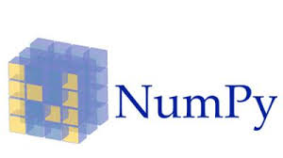
Numpy
Offers Matlab-ish capabilities within Python,
Fast array operations,
2D arrays, multi-D arrays, linear algebra etc.
http://www.numpy.org/

Slide 12

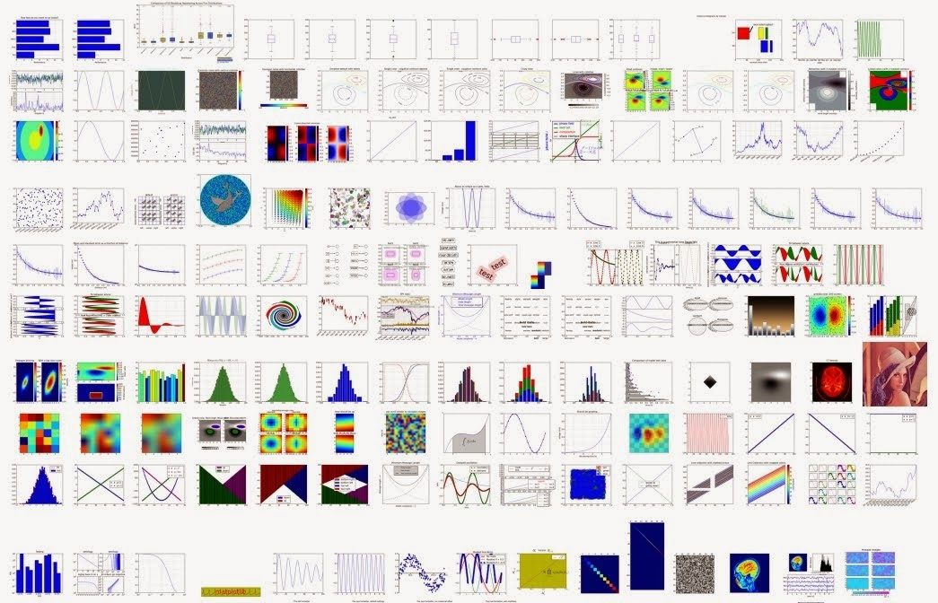
Matplotlib
High quality plotting library
“…you have full control of line styles, font properties, axes properties, etc, via an object oriented interface or via a set of functions familiar to MATLAB users”

Slide 13

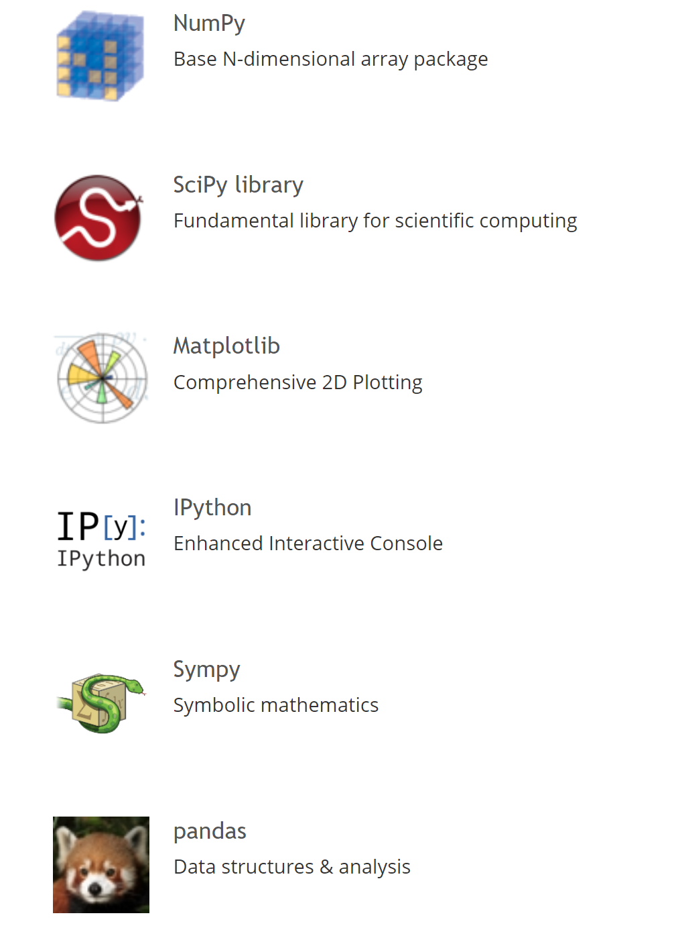
Scipy
Scientific Computing Tools for Python
Fundamental libraries for mathematics, science, and engineering,
Signal processing (scipy.signal)
“SciKits (short for SciPy Toolkits), are add-on packages for SciPy, hosted and developed separately from the main SciPy distribution.”
Scikit-learn
Scikit-image
http://scikits.appspot.com/scikits

Slide 14
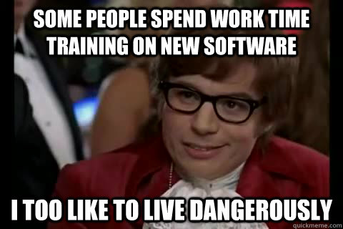
Demo

Slide 15
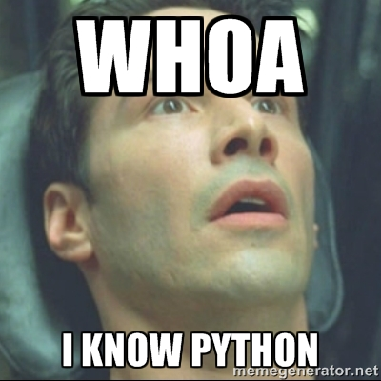
Curious? Give it a try!

